Slide 1
Software Development & Programming languages
Module 1 Day 4
Notes:
<number>

Slide 2
Programming Languages
By the end of the lesson, students must be able to:
Define High, low level languages
Identify different programming languages
Explain the concepts of variables
Start a hello world in (Python or Javascript) and also making use of variables.
Notes:
A programming language is a set of rules that provides a way of telling a computer what operations to perform A programming language is a tool for developing executable models for a class of problem domains
<number>

Slide 3
Programming Languages
Are essentially a vocabulary and set of grammatical rules for instructing a computer to perform specific tasks.
Programming languages are grouped into categories like:
First generation languages
Second generation languages
Third generation languages
Fourth generation languages
Fifth generation languages
Notes:
A programming language is a set of rules that provides a way of telling a computer what operations to perform A programming language is a tool for developing executable models for a class of problem domains
<number>

Slide 4
First Generation Languages
Programs were coded in binary code (1’s and 0’s) which is machine language. First generation languages were fast since they needed not to be converted.
One of the disadvantages was portability meaning they could not be used on another computer with different architecture.
Another disadvantage is that they are very difficult to code and debug.
Debug means checking for errors
Notes:
4

Slide 5
Second Generation Languages (2GL)
These were also known as assembly languages.
2GL needed to be compiled into machine language.
2GL had speed advantage but very difficult to code
Notes:
5

Slide 6
Third Generation Language (3GL)
Is a high level language.
High level languages are closer to human language and each statement generates many statements in low level language. Translation from HLL to LLL require a translator
There are two types of translators:
a) compiler
b) Interpreter
Notes:
Tip: Add your own speaker notes here.
6

Slide 7
Translators
Compiler- Converts the whole soft code into object/machine code
Interpreter-Converts line by line. Interpreters are slow as compared to compilers.
Translation of source code are all features of an Integrated Development Environment (IDE).
IDE provides source code editor, screen design and debuggers.
Notes:
7

Slide 8
Fourth Generation Languages
These were developed with specific purpose in mind and for use by end-users.
FOUR basic categories of 4GL
Query languages-used in databases
Report generators-for report writing
Graphic languages-for drawings
Application generators-
Notes:
8

Slide 9
Fifth Generation Languages
Is more closer to human languages.
Mainly common for artificial intelligence
5GL uses graphical development interface
Do not need algorithm
An algorithm is a step by step solution for developing a program

Slide 10
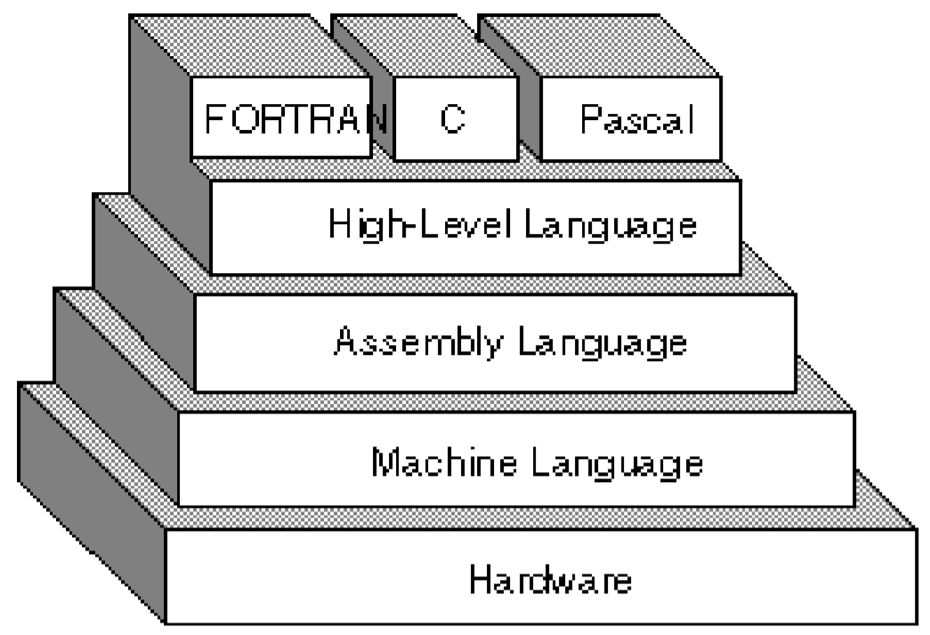
Introduction to programming
Notes:
High-level languages are much closer to human language. A programming language such as C, FORTRAN or Pascal that enables to write programs which is understandable to programmer (Human) and can perform any sort of task, such languages are considered high-level because they are closer to human languages. High level language must use interpreter, compiler or translator to convert human understandable program to computer readable code (machine code).
A computer low level language that deals with hardware registers by name is known as assembly language. Assembly language is the best example of low level language, it is in between machine language and highlevel language. A low-level language does not need a compiler or interpreter to run the program, the processor run low-level code directly.
Assembly Languages-It uses mnemonic codes (short forms) for instructions and allows the programmer to introduce names for blocks of memory that hold data. Assembly language is designed to be easily translated into machine language
8

Slide 11
Variables
A storage location in memory (RAM)
Holds data/information while the program is running
Every variable has three properties:
Name
Value
Data Type
Notes:
Name - reference to the location - cannot be changed
Value - the information that is stored - can be changed during program execution, hence the name “variable”
Data Type - the type of information that can be stored - cannot be changed
8

Slide 12
How to Think About Variables
You are the programmer make up a name for the variable
The programming language associates that name with a location in the computer's RAM
Notes:
The value currently associated with the variable is stored in that memory location
You simply use the name you chose when you need to access the value
8

Slide 13
Usage of Variables
Copy and store values entered by the user
Perform arithmetic manipulation on values
Test values to see if they meet a criteria
Temporarily hold and manipulate the value of a control property
Hold data/information so that it can be recalled for use at a later point in the code
Notes:
8

Slide 14
Choosing Data Type
Data type - Specifies type of data variable can store
Integer variables: Long, Integer, Short, Byte
Floating-point variables: Single, Double
Fixed decimal point variable: Decimal
Boolean variables: True, False
Character variable: Char
Text variable: String
The Object variable
Default data type assigned by Visual Basic
Can store many different types of data
Less efficient than other data types
Notes:
8

Slide 15
Data Types
Data type Prefix Size Values
Byte byt 1 byte positive integer value from 0 to 255
Short shr 2 byte integer from –32,768 to +32,767
Integer int 4 byte integer from +/- 2,147,483,647
Long lng 8 byte integer from +/- 9,223,372,036,854,775,807
Double dbl 8 byte double-precision, floating-point number
Decimal dec 16 byte number with up to 28 significant digits
Char chr 2 byte Any single character
Boolean bln 2 byte True or False
String str (4 byte) Text - Any number/combination of characters
Date dtm 8 byte 8 character date: #dd/mm/yyyy#
Object obj (4 byte) An address that refers to an object
Notes:
Byte byt 1 byte positive integer value from 0 to 255
Short shr 2 byte integer from –32,768 to +32,767
Integer int 4 byte integer from +/- 2,147,483,647
Long lng 8 byte integer from +/- 9,223,372,036,854,775,807
Double dbl 8 byte double-precision, floating-point number
Decimal dec 16 byte number with up to 28 significant digits
Char chr 2 byte Any single character
Boolean bln 2 byte True or False
String str (4 byte) Text - Any number/combination of characters
Date dtm 8 byte 8 character date: #dd/mm/yyyy#
Object obj (4 byte) An address that refers to an object
8

Slide 16
Default Values for Data Types
Data type Default (Initial) value
All numeric types Zero (0)
Boolean False
Char Binary 0
String or Object Empty
Date 12:00 a.m. on January 1, 0001
Notes:
<number>

Slide 17
Variable Names
First character must be a letter or underscore
Must contain only letters, numbers, and underscores (no spaces, periods, etc.)
Can have up to 255 characters
Cannot be a language keyword
Naming Conventions
Should be meaningful
Follow 3 char prefix style - 1st 3 letters in lowercase to indicate the data type
After that, capitalize the first letter of each word
Example: intTestScore
Notes:
<number>

Slide 18
Variables
A variable is created as soon as we assign a value to it. Some languages also do not require specifying the data type of the variable unlike other programming languages.
For example, Python is a type inferred language, i.e., it automatically detects the type of the assigned variable
Multiple Variable Assignment
Notes:
<number>

Slide 19
Literal
Actual value/data/information
Similar to a variable, but can NOT change during the execution of a program.
Examples of Literals:
Numeric: 5 ; 157 ; 195.38256
String: “Paul” ; “Hello!!!” ; “Jackson, AL 36545”
Char: ‘a’ ; ‘1’ ; ‘?’ ; ‘@’
Boolean: True ; False
Notes:
hhhhhhh
<number>

Slide 20
Named Constants (cont.)
Use of named constants resolves both these issues
Can declare a variable whose value is set at declaration and cannot be changed later:
Syntax: Const CONST_NAME As DataType = Value
Looks like a normal declaration except:
Const used instead of Dim
An initialization value is required
By convention, entire name capitalized with underscore characters to separate words
Notes:
<number>

Slide 21
Scope of Variables
What – Indicates the part of the program where the variable can be used
When – From the variable declaration until the end of the code block (procedure, method, etc.) where it is declared
Variable cannot be used before it is declared
Variable declared within a code block is only visible to statements within that code block
Called Local Variable
Can be declared at the beginning of the class code window (General Declarations section) and be available to all blocks
Called Form Level Variable
Variables that share the same scope cannot have the same name (same name ok if different scope)
Notes:
<number>

Slide 22
Lifetime of Variables
What – Indicates the part of the program where the variable exists in memory
When – From the beginning of the code block (procedure, method, etc.) where it is declared until the end of that code block
When the code block begins the space is created to hold the local variables
Memory is allocated from the operating system
When the code block ends the local variables are destroyed
Memory is given back to the operating system
Notes:
<number>

Slide 23
Assignment Statement
Syntax: variablename = expression
Assigns the value of the expression to the variable. (The variable must be on the left and the expression on the right.)
Example:
intNumber1 = 4
intNumber2 = 3 * (2 + 2)
intNumber3 = intNumber1
IntNumber1 = intNumber1 + 6
Notes:
hhhhhhh
<number>

Slide 24
Performing Calculations with Variables
Arithmetic Operators
^ Exponential
* Multiplication
/ Floating Point Division
\ Integer Division
MOD Modulus (remainder from division)
+ Addition
– Subtraction
& String Concatenation (putting them together)
Notes:
<number>

Slide 25
Common Arithmetic Operators
Examples of use:
decTotal = decPrice + decTax
decNetPrice = decPrice - decDiscount
dblArea = dblLength * dblWidth
sngAverage = sngTotal / intItems
dblCube = dblSide ^ 3
Notes:
<number>

Slide 26
Special Integer Division Operator
The backslash (\) is used as an integer division operator
The result is always an integer, created by discarding any remainder from the division
Example
intResult = 7 \ 2 ‘result is 3
shrHundreds = 157 \ 100 ‘result is 1
shrTens = (157 - 157 \ 100 * 100) \ 10
‘result is ?
Notes:
<number>

Slide 27
Special Modulus Operator
This operator can be used in place of the backslash operator to give the remainder of a division operation
intRemainder = 17 MOD 3 ‘result is 2
dblRemainder = 17.5 MOD 3 ‘result is 2.5
Any attempt to use of the \ or MOD operator to perform integer division by zero causes a DivideByZeroException runtime error
Notes:
<number>

Slide 28
Concatenating Strings
Concatenate: connect strings together
Concatenation operator: the ampersand (&)
Include a space before and after the & operator
Numbers after & operator are converted to strings
How to concatenate character strings
strFName = "Bob"
strLName = "Smith"
strName = strFName & " “ → “Bob ”
strName = strName & strLName → “Bob Smith”
intX = 1 intY = 2
intResult = intX + intY
strOutput = intX & “ + “ & intY & “ = “ & intResult → “1 + 2 = 3”
Notes:
<number>

Slide 29
Combined Assignment Operators
Often need to change the value in a variable and assign the result back to that variable
For example: var = var – 5
Subtracts 5 from the value stored in var
Operator Usage Equivalent to Effect
+= x += 2 x = x + 2 Add to
-= x -= 5 x = x – 5 Subtract from
*= x *= 10 x = x * 10 Multiply by
/= x /= y x = x / y Divide by
\= x \= y x = x \ y Int Divide by
&= x &= “.” x = x & “.” Concatenate
Notes:
<number>

Slide 30
Arithmetic Operator Precedence
Operator precedence tells us the order in which operations are performed
From highest to lowest precedence:
Exponentiation (^)
Multiplicative (* and /)
Integer Division (\)
Modulus (MOD)
Additive (+ and -)
Parentheses override the order of precedence
Where precedence is the same, operations occur from left to right
Notes:
<number>

Slide 31
All Operators Precedence
Parenthesis
Exponential
Multiplication / Division
Integer Division
MOD
Addition / Subtraction
String Concatenation
Relational Operators (< , > , >= , <= , <>)
Logical Operators (AND, OR, NOT)
Notes:
<number>

Slide 32
Precedence Examples
6 * 2 ^ 3 + 4 / 2 = 50
7 * 4 / 2 – 6 = 8
5 * (4 + 3) – 15 Mod 2 = 34
intX = 10
intY = 5
intResultA = intX + intY * 5 'iResultA is 35
iResultB = (intX + intY) * 5 'iResultB is 75
dResultA = intX - intY * 5 'dResultA is -15
dResultB = (intX - intY) * 5 'dResultB is 25
Notes:
<number>

Slide 33
Homework
Lets start a python project using online interpreter by clicking the following link
https://repl.it/languages/python3
OR
https://www.onlinegdb.com/online_python_interpreter
Type the following :
Print(“hello world”)
Press the run button Output will be printed on to the screen.
Notes:
<number>

Slide 34
Programming Examples
Print times table eg. 5 x table
Notes:
<number>

Slide 35
Hello World in Python
# My first program using Python. print("hello world") # printing helloworld decPrice = 2.50 # declaring variable for Unitprice intTotal = 5 # declaring number of total items x = int(input("enter milk")) * int(input("enter value")) print(x) intTotal=7 DecAmount = decPrice * intTotal # performing my calculation print(DecAmount) # displaying my answer print(type(DecAmount)) # checking the datatype of DecTotal print(type(intTotal)) # checking the datatype of in8tTotal
Notes:
Try the following exercise with the learners
<number>

